Slide 1
BIIT Attendance System
Supervised By:
Sir Zahid
Presented by:
Hamza Fayyaz
2016-arid-0069

Slide 2
Objectives:
The main objective is to help teachers in marking the attendance of students.
Students can also see their marked attendance after login into application. They can also be updated related to attendance percentage via mobile text messages.
Amin can also keep everything in check and balance related to attendance.

Slide 3





Conceptual Diagram
Login the app locks the attendance for
no. of days. Changes the short attendance percentage
Web Sever
Request
Admin
Response
Response
Request
Response
Mark attendance after login. adds students
Attendance app
Response
Logins to app to view the attendance
Teacher
Response
DB
Student

Slide 4
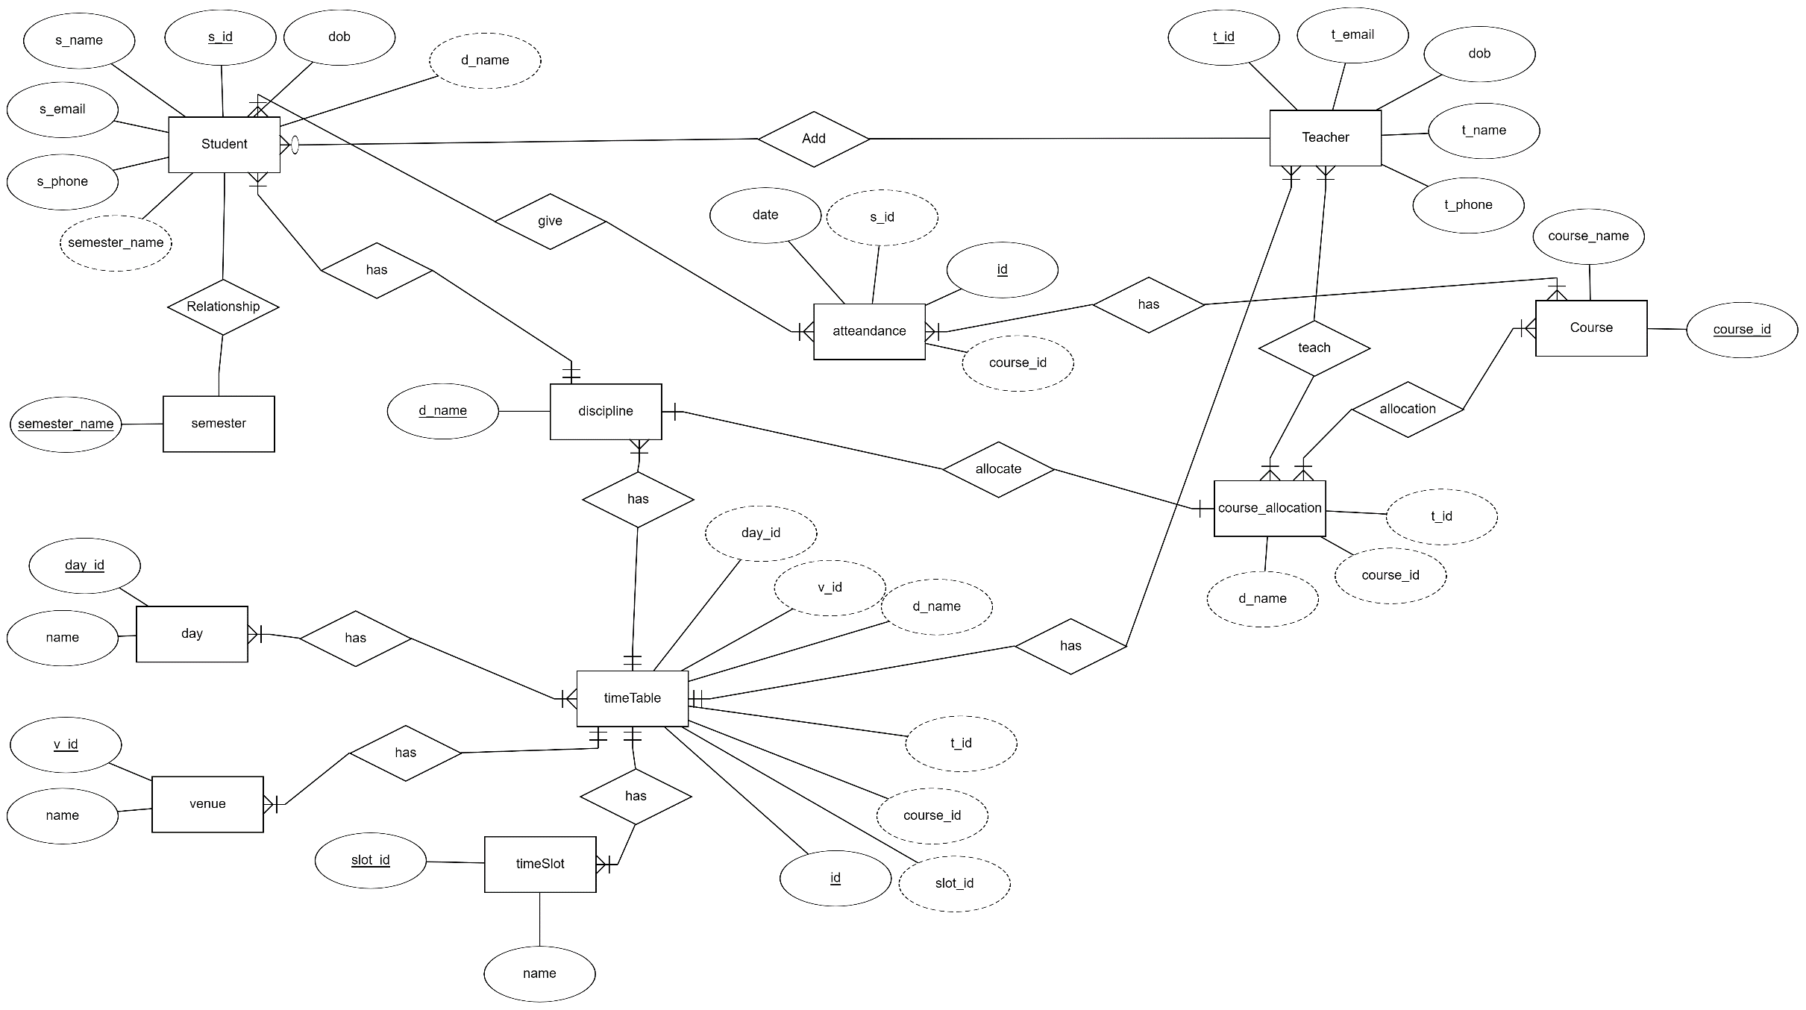
ERD

Slide 5
DFD(Data Flow Diagram) Level 0
Request
Attendance System
Response
Admin
Student
Response
Request
Response
Request
Teacher

Slide 6
Level 1(2.0)
Request
View Attendance
Request to View
Response
Response
Admin
Request
Attendance Lock
Lock Request
Database
Response
Response
Request
Short Attendance %
Update Request
Response
Response

Slide 7
Level 1(2.0)
Request
View Attendance
Request to View
Response
Response
Teacher
Request
Mark Attendance
Submit
Database
Response
Response
Request
Add Student
Add Record
Response
Response

Slide 8
Level 1(3.0)
Request
View Attendance
Request to View
Response
Response
Student
Database
Text Message Notification
Request
Response
Response

Slide 9
Tools and Technologies:
Visual Studio Code
Visual Studio
Sql Server
iPhone Emulator
Google Chrome

Slide 10
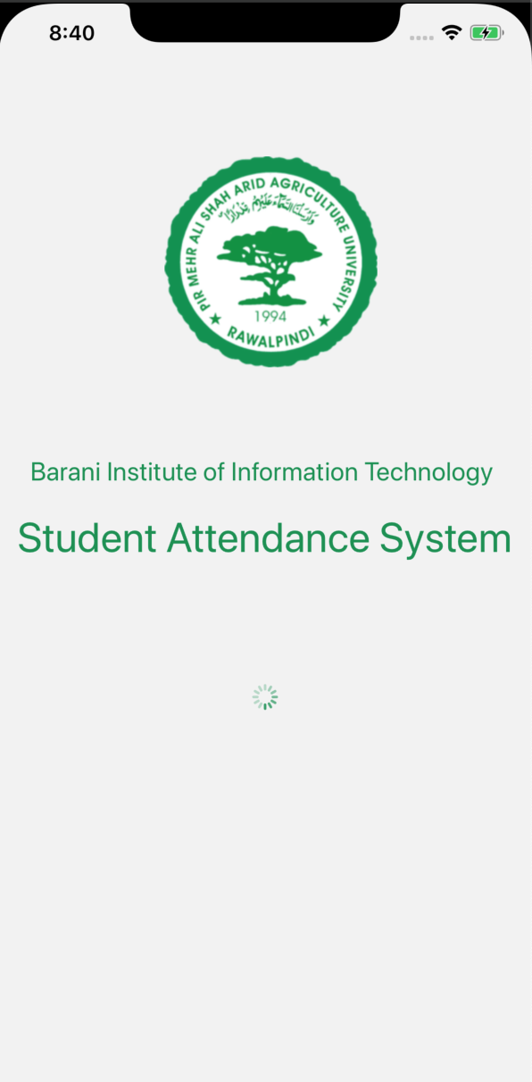
Screen Shots

Slide 11
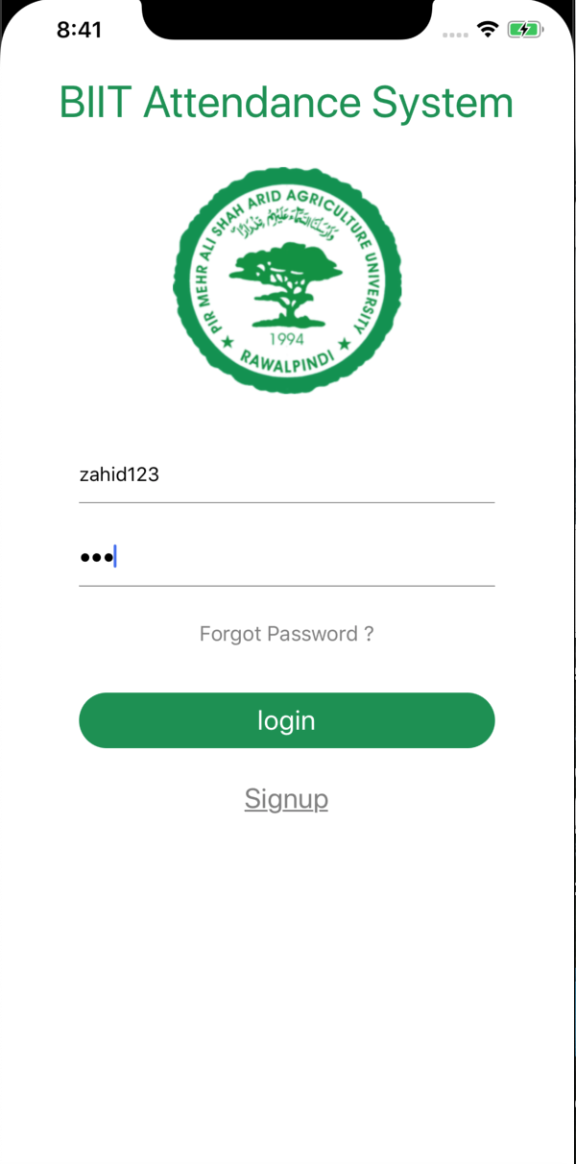
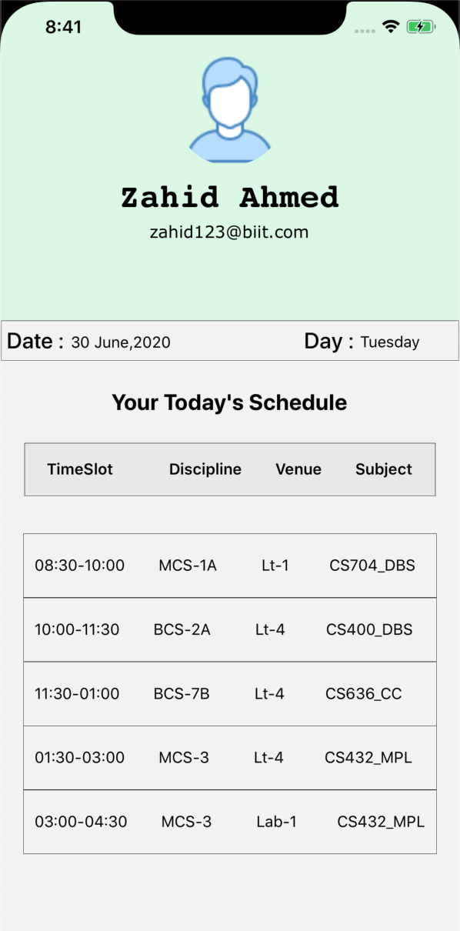

Slide 12
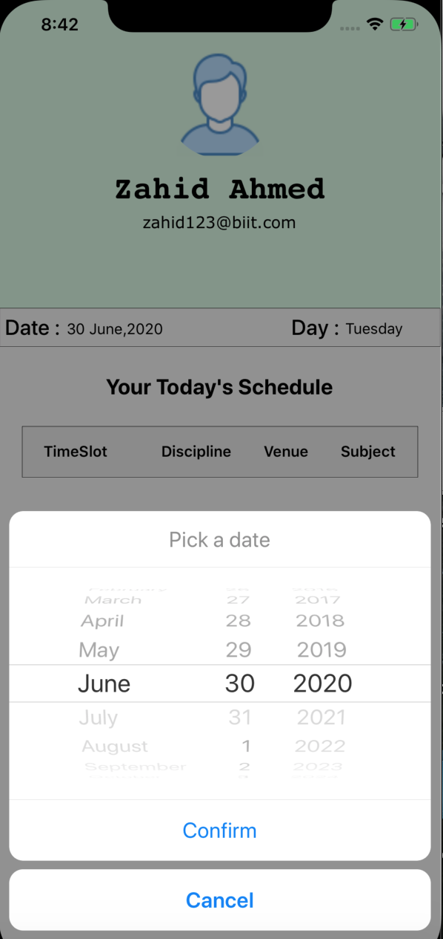
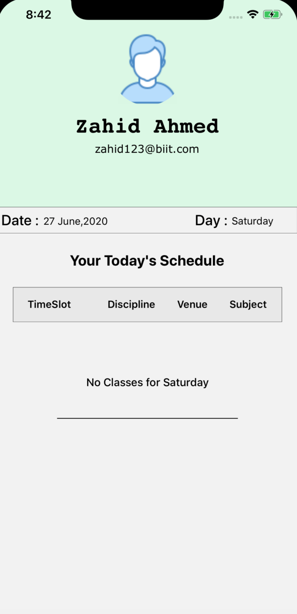

Slide 13
